Slide 1


Intelligent Exam Generator
Automating Personalized Assessments for Computer Science Education
Supervisor: Dr: Mostafa Salama
Sun 15 Jun 2025

Slide 2

How many times did you struggled creating fair, varied examinations due to time constraints.
And how many times you needed a smarter solution to simplify and speed up this process?

Slide 3
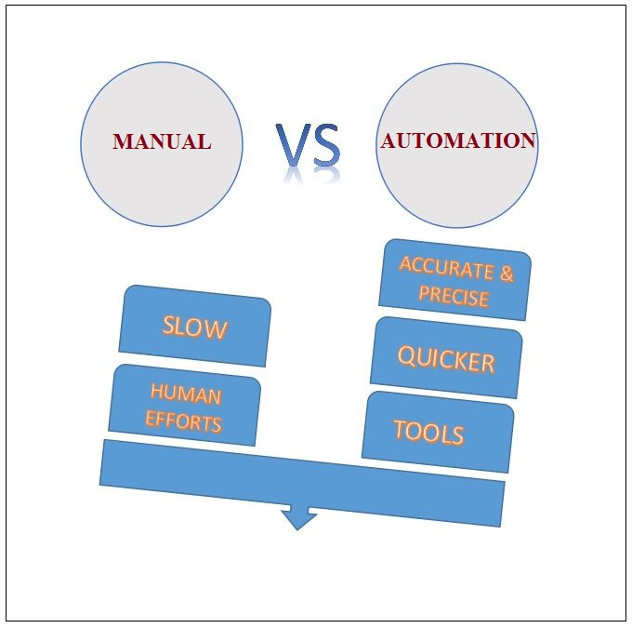
Introduction
Manual exam creation is time-consuming, lacks personalization, and fails to adapt to student progress.
Solution: AI-driven tool using NLP and deep learning to automate exam generation.
Impact: Saves educators time, enhances learning with scalable, personalized assessments.

Slide 4

Existing Work:
OpenAI's GPT-based models for QA and QG.
T5/BART models for question generation from text.
RACE, SQuAD, and MS MARCO as benchmark datasets.
Gaps Identified:
Lacks personalization
Limited distractor generation techniques.
Need for a unified system integrating the whole exam making process.
Literature Review

Slide 5
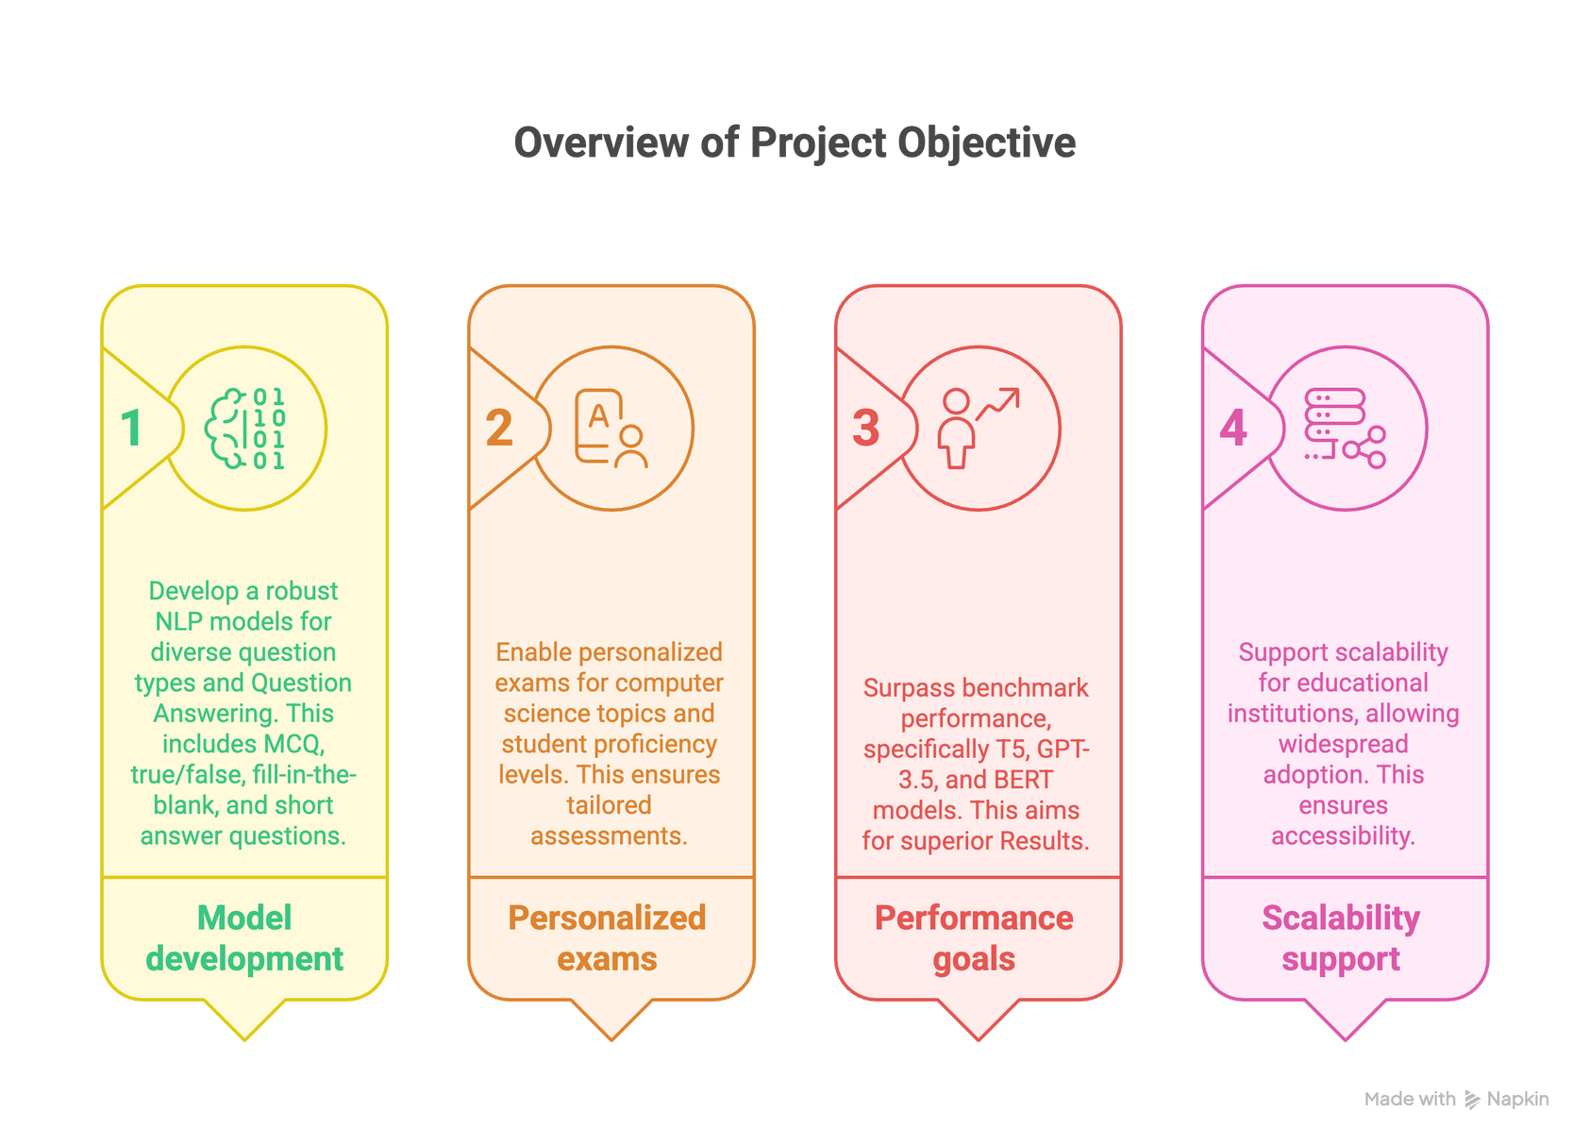
Objectives

Slide 6
Sequential Workflow:
Input Processing: Accepts computer science materials (lecture notes, exams, slides) as text.
Question Generation (SciFive T5): Fine-tuned T5 model generates diverse questions (MCQ, true/false, fill-in-the-blank) based on input context, ensuring semantic relevance.
Question Evaluation (LLaMA-2-7B): Validates questions by generating reference answers, ensuring accuracy and alignment with input materials.
Distractor Generation (Google Flan-T5): Creates plausible incorrect MCQ options, enhancing question challenge and educational value.
Difficulty Adjustment (DistilBERT): Analyzes student proficiency (from synthetic profiles) to adjust question complexity (easy, medium, hard).
Output: Personalized exams with varied question types, tailored difficulty, and high-quality distractors.
System Architecture

Slide 7
Overview: Developed tailored datasets from British University in Egypt (BUE) Informatics and Computer Science (ICS) faculty materials to drive AI-driven exam generation.
Source Materials:
Compiled four years of lectures, exams, lab manuals, slides, and assignments.
Focused on computer science topics (e.g., NLP, Data Structures, Cybersecurity).
Creation Process:
Converted materials to plain text, structured as JSON.
Curated by experts to ensure clarity, relevance, and educational value.
Significance:
Enables precise, curriculum-aligned exam generation.
Sets a new standard for educational AI datasets.
Custom BUE ICS Datasets

Slide 8
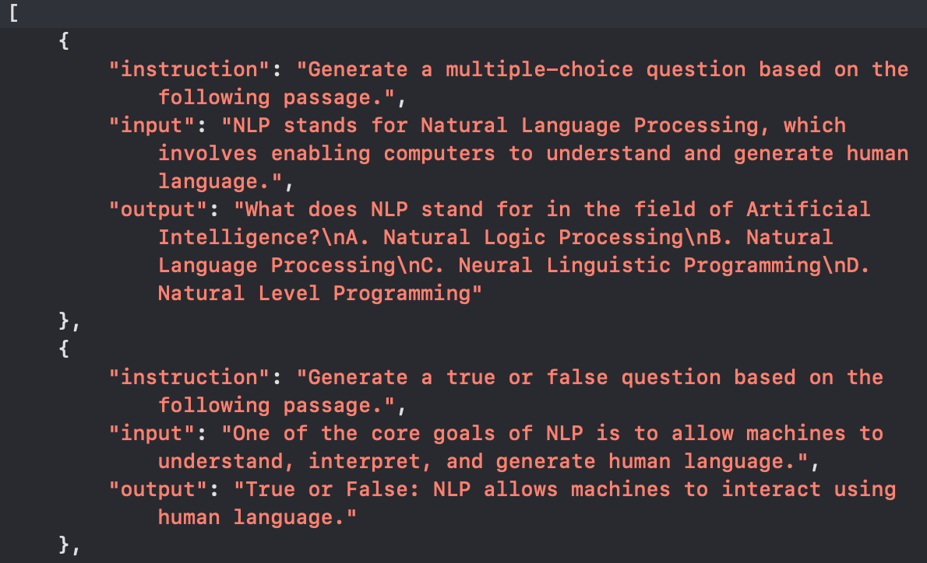
Question Generation Dataset
Structure: Comprises diverse question types (MCQ, true/false, fill-in-the-blank, short answer), each with an instruction, input passage, and output question.
Custom BUE ICS Datasets

Slide 9
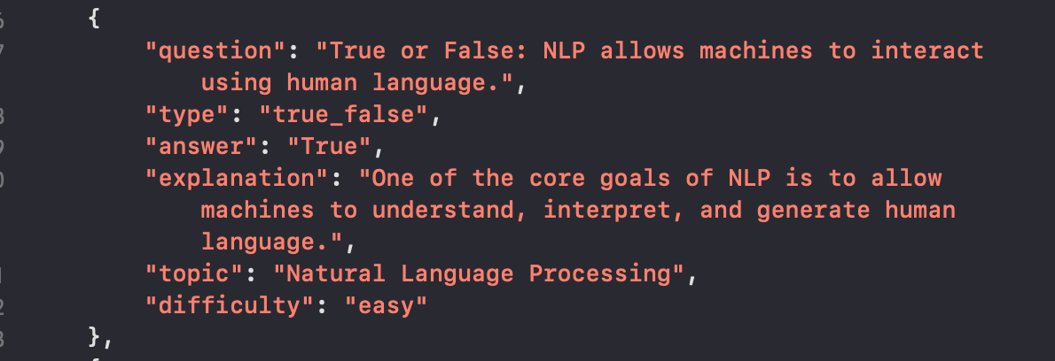
Question Answering Dataset
Structure: Comprises diverse question types (MCQ, true/false, fill-in-the-blank, short answer), each including a question, answer, options (for MCQs), explanation, topic, and difficulty level.
Custom BUE ICS Datasets

Slide 10
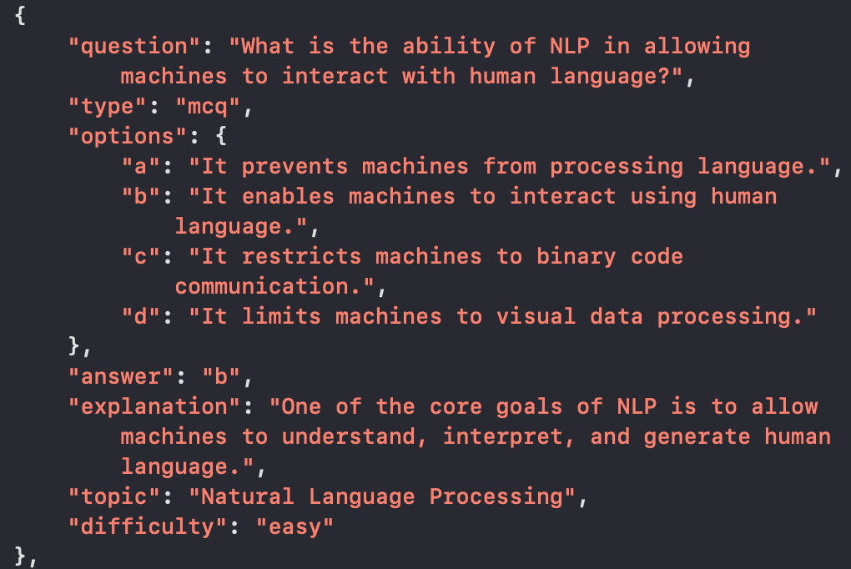
Distractor Generation Dataset
Structure: Comprises MCQ questions , each with a question, four options, correct answer, explanation, topic, and difficulty level, designed for distractor generation.
Custom BUE ICS Datasets

Slide 11

Implementation &
Results

Slide 12
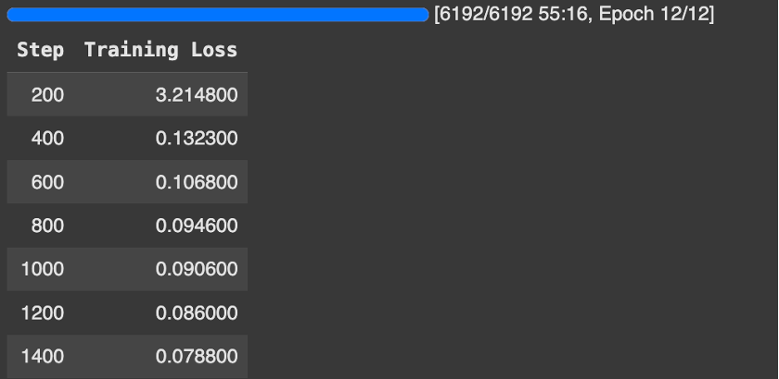

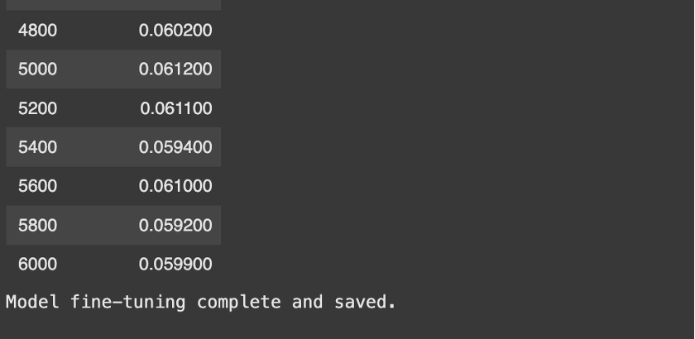
Model 1: Question Generation
Robust learning took place because the loss fell from 3.2148 at the beginning to 0.0599
Implementation &
Results

Slide 13
Model 1: Question Generation Results
Performance:
METEOR: 0.9054, BLEU: 0.1503, ROUGE-L: 0.4175.
Example: “What is symmetric vs. asymmetric encryption?” (confidence 0.985).
Benchmark Comparison:
Surpasses T5 (METEOR: 0.83), GPT-3.5 (0.85), BERT (0.70).
Significance: High semantic accuracy, diverse question types for computer science.
Implementation &
Results

Slide 14
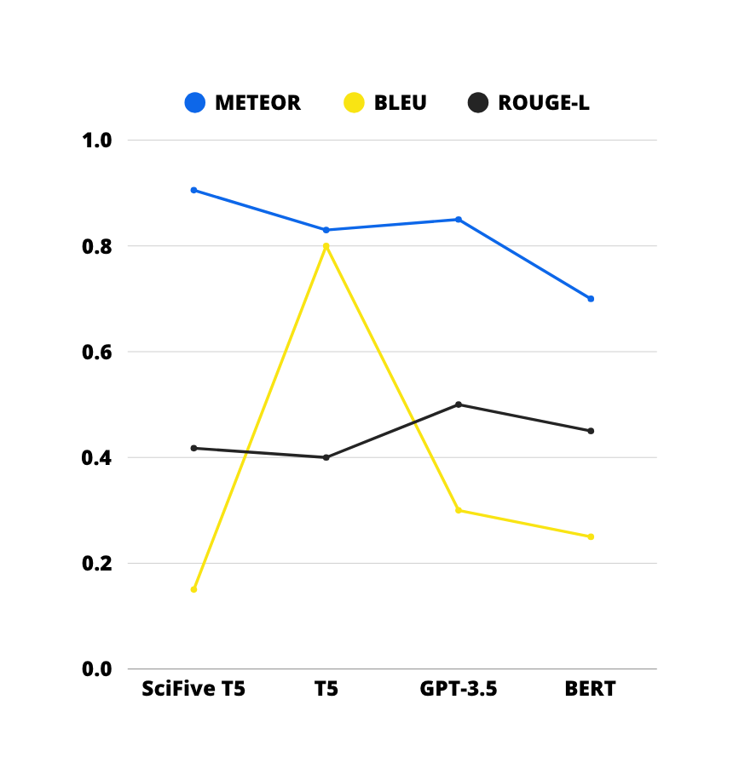
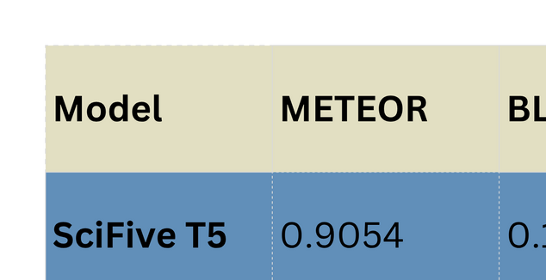
Model 1: Question Generation Results
Sources: [1], [2], [3]

Slide 15
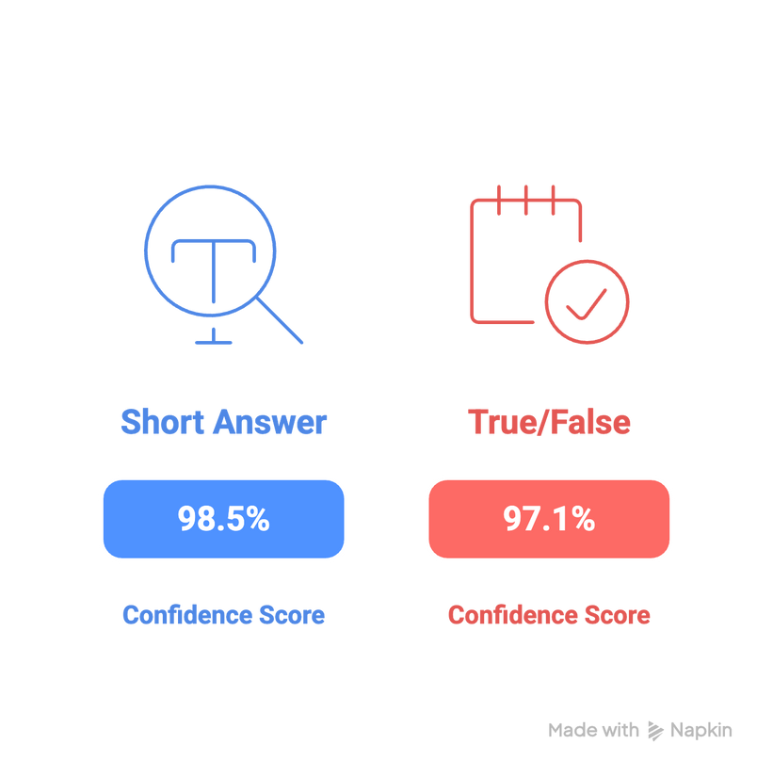
Model 1: Question Generation Inference
Q: Short Answer Question.
Context: “Symmetric encryption uses the same key for both encryption and decryption, while asymmetric encryption uses a pair of keys: a public key for encryption and a private key for decryption.”
Generated Question: “What is the difference between symmetric and asymmetric encryption?”
Confidence Score: 0.985
Analysis: Correct and concise, aligning well with the context and instruction.
Q: True or False Question.
Context: “Non-maximum suppression is used to thin the edges by suppressing pixels that are not local maxima in the gradient direction, ensuring that only the most prominent edges are retained.”
Generated Question: “True or False: Non-maximum suppression thins edges by suppressing pixels that are not local maxima.”
Confidence Score: 0.971 o Analysis: Accurate and appropriately formatted as a true/false question.

Slide 16
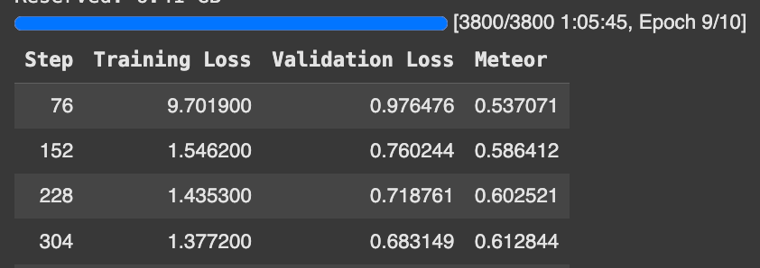


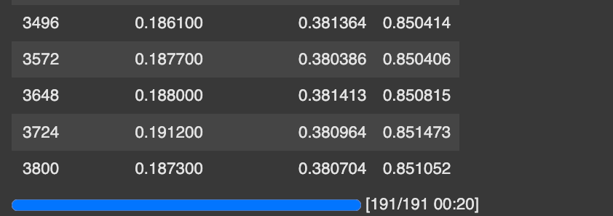
Model 2: Question Answering
There was a big drop in training loss from 9.7019 to 0.1873 showing that learning worked well.
Validation loss went from 0.9765 to 0.3807, demonstrating better abilities to generalize.
The validation METEOR score went up from 0.5371 to 0.8511 which means the answers were accurately semantic most of the time.
Implementation &
Results

Slide 17
Model 2: Question Answering
Performance:
METEOR: 0.8540, EM: 49.34, F1: 60.20.
Example: Correctly computed Levenshtein distance (“flaw” to “lawn” = 2).
Benchmark Comparison:
Outperforms BERT (0.70), LLaMA-2-13B (0.75); rivals GPT-3.5 (0.85).
Significance: Robust answers for complex NLP tasks, enhancing exam reliability.
Implementation &
Results

Slide 18
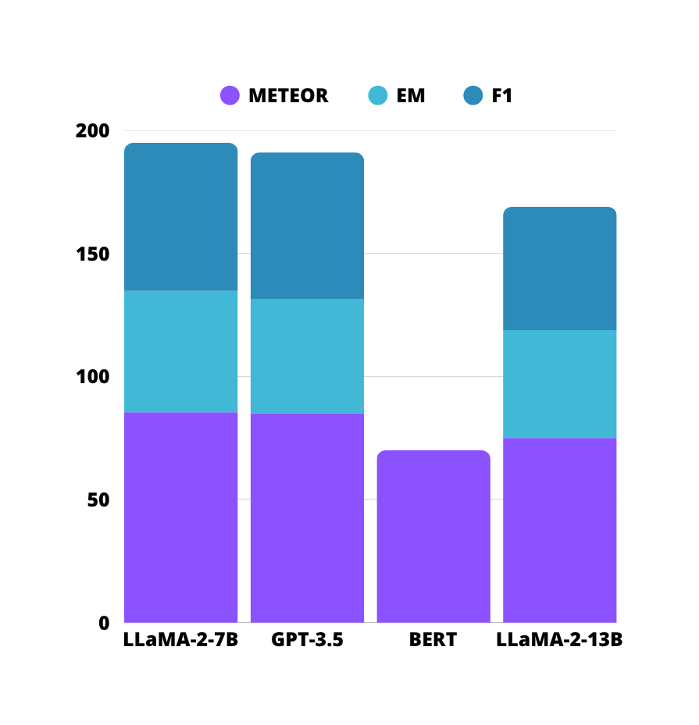
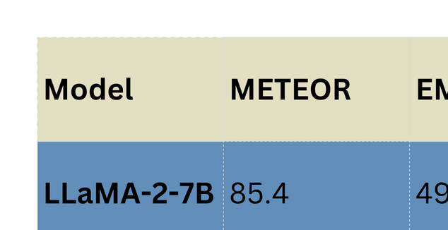
Model 2: Question Answering Results
Sources: [4], [5]

Slide 19
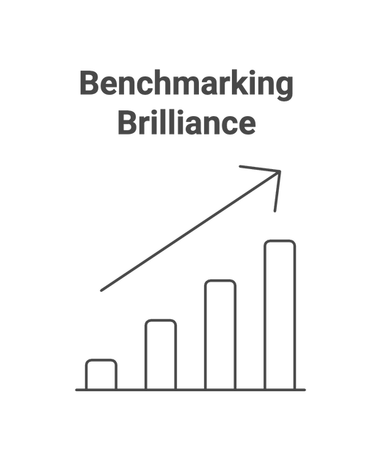
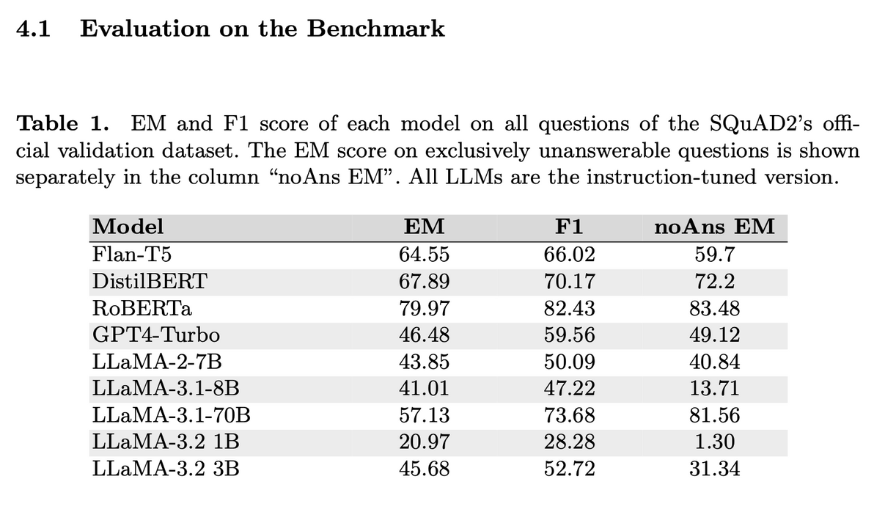
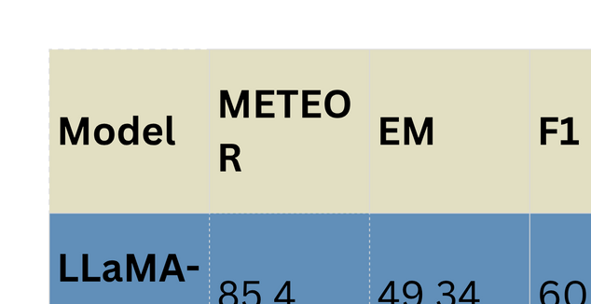
Model 2: Question Answering Results
Source: Fischer et al. (2024)

Slide 20
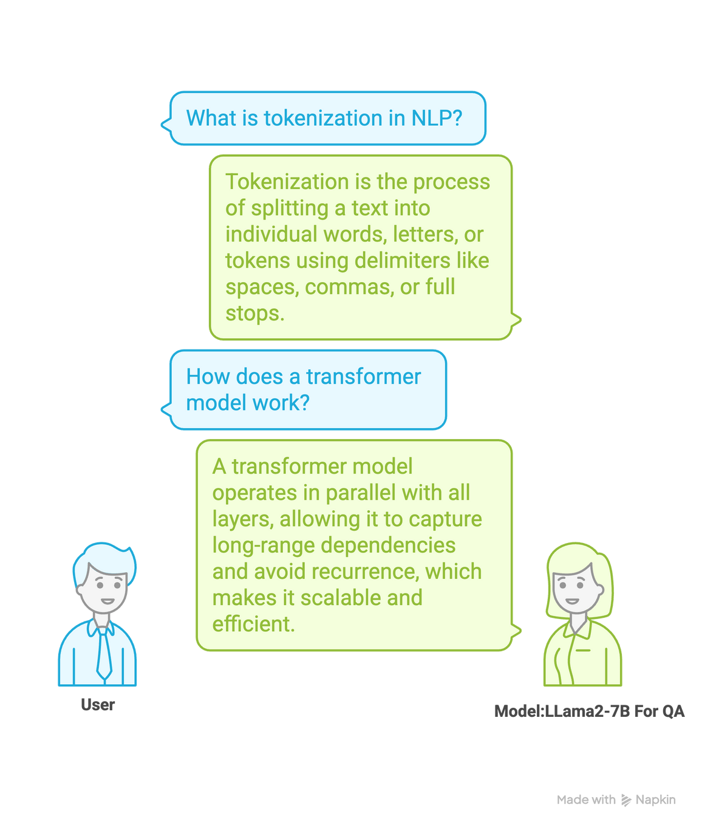
Model 2: Question Answering Inference
Q: What is tokenization in NLP?
Predicted Answer: “Tokenization is the process of splitting a text into individual words, letters, or tokens using delimiters like spaces, commas, or full stops.”
Analysis: Correct and concise, accurately describing the tokenization process.
Q: How does a transformer model work?
Predicted Answer: “A transformer model operates in parallel with all layers, allowing it to capture long-range dependencies and avoid recurrence, which makes it scalable and efficient.”
Analysis: Accurate, capturing key aspects of transformer architecture.

Slide 21
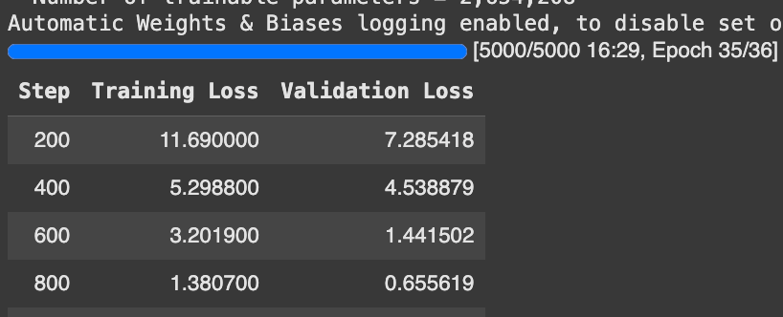

Model 3: Distractor Generation
Training loss impressively reduced from 11.69 (step 200) to 0.3951 (step 5000).
Validation loss steadily dropped from 7.2854 (step 200) to 0.3175 (step 5000).
The model generated distractors for all 70 validation MCQs, demonstrating robust performance.
Implementation &
Results

Slide 22
Model 3: Distractor Generation
Performance:
BLEU: 0.29, ROUGE: 0.53, METEOR: 0.39.
Example: Distractors like “Neural Language Processing” for NLP MCQ.
Benchmark Comparison:
Competitive with GPT-3.5 (BLEU: 0.30, ROUGE: 0.50); surpasses BERT (BLEU: 0.25).
Significance: Plausible distractors enhance MCQ challenge and educational value.
Implementation &
Results

Slide 23
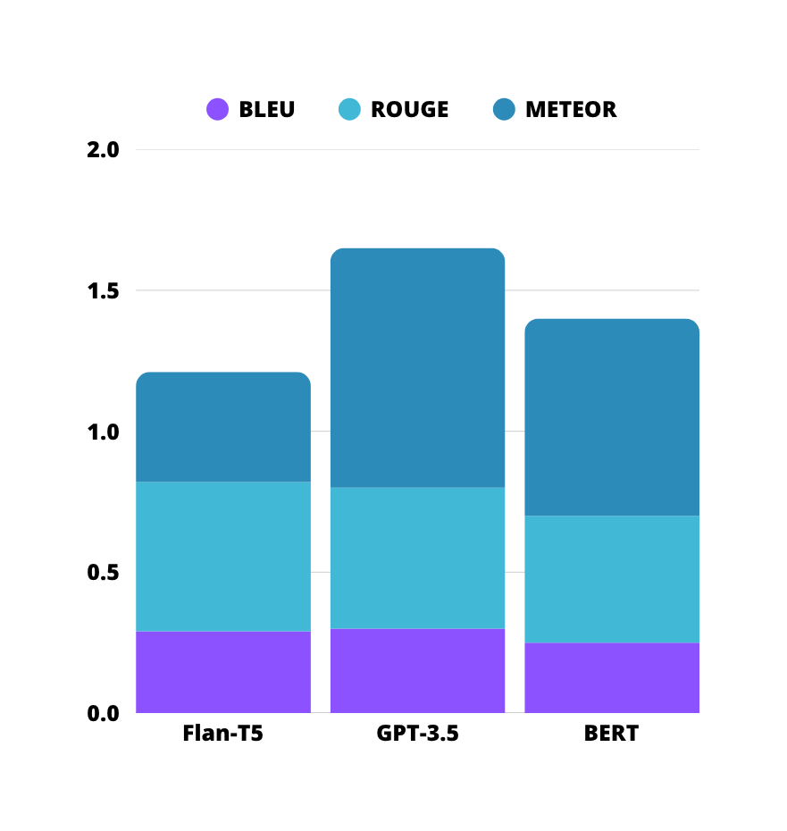
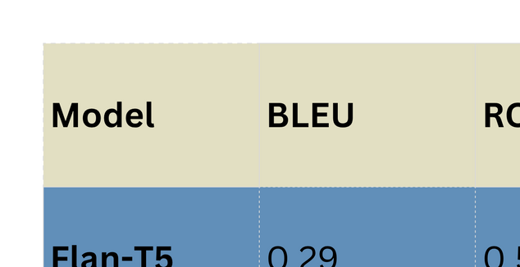
Model 3: Distractor Generation Results
Sources: [6]

Slide 24
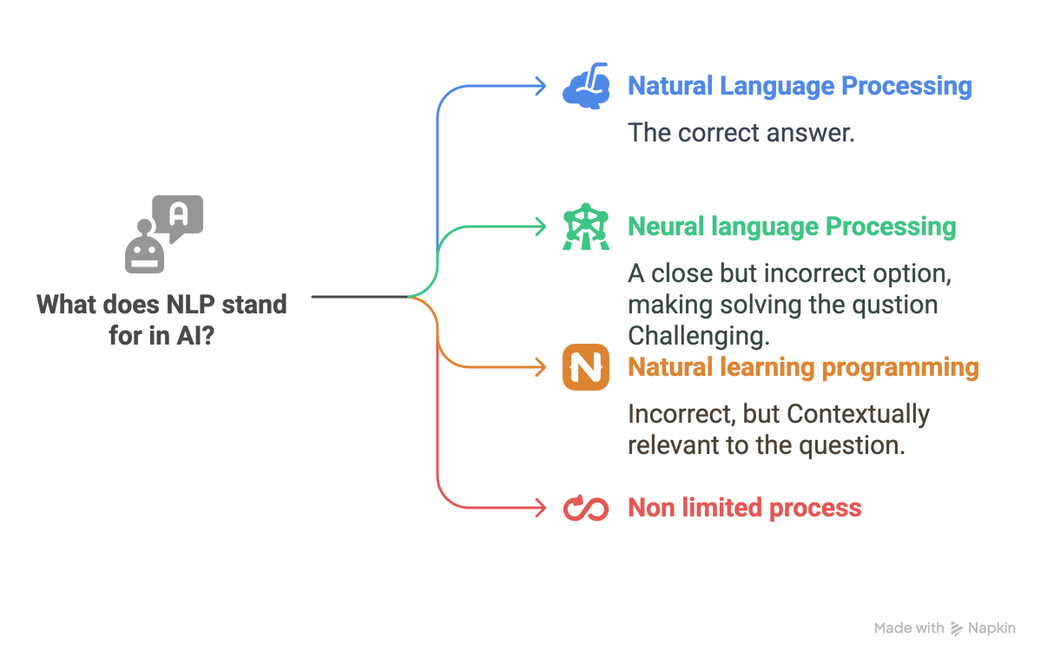
Model 3: Distractor Generation Inference
Question: What does NLP stand for in the field of Artificial Intelligence?
Correct Answer: Natural Language Processing
Predicted Distractors: Neural language Processing; Natural learning programming; Non limited process
Analysis: The distractors are highly promising, with "Neural language Processing" and "Natural learning programming" closely mimicking the correct answer’s structure, showcasing the model’s grasp of NLP-related terms. "Non limited process" adds variety, offering a unique perspective.

Slide 25
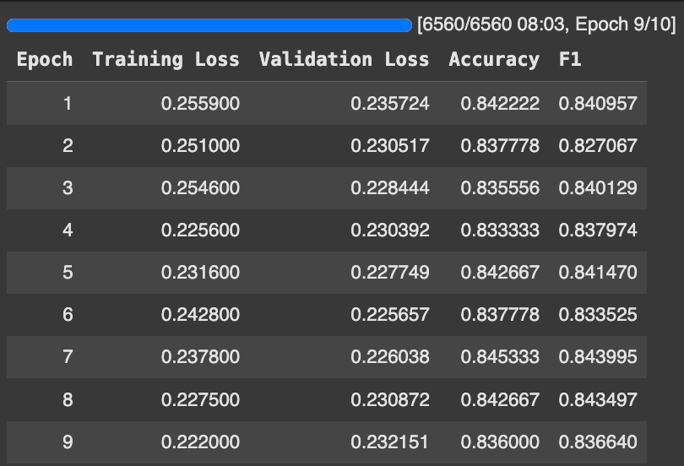


Model 4: Difficulty Adjuster
DistilBERT was chosen for how well it performs in the task of text classification.
The foundation of the study included:
Classifying Skill Level through Course, Topic Mastered, Past Score and Grade.
Implementation &
Results

Slide 26
Model 4: Difficulty Adjuster
Performance:
Accuracy: 0.8382, F1: 0.8365, AUC: 0.98 (Advanced), 0.99 (Beginner), 0.94 (Intermediate).
Example: Beginner-level SQL questions for low-scoring students.
Significance: Enables adaptive assessments for diverse learner profiles.
Implementation &
Results

Slide 27
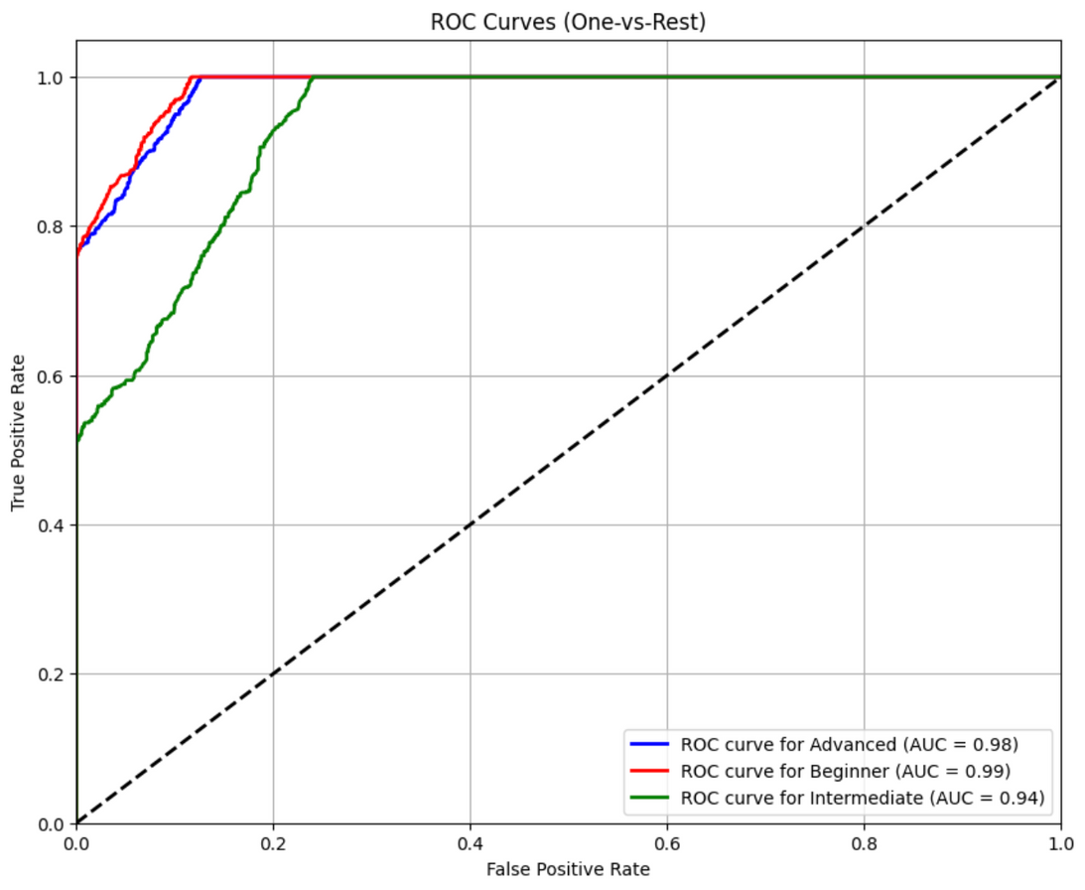
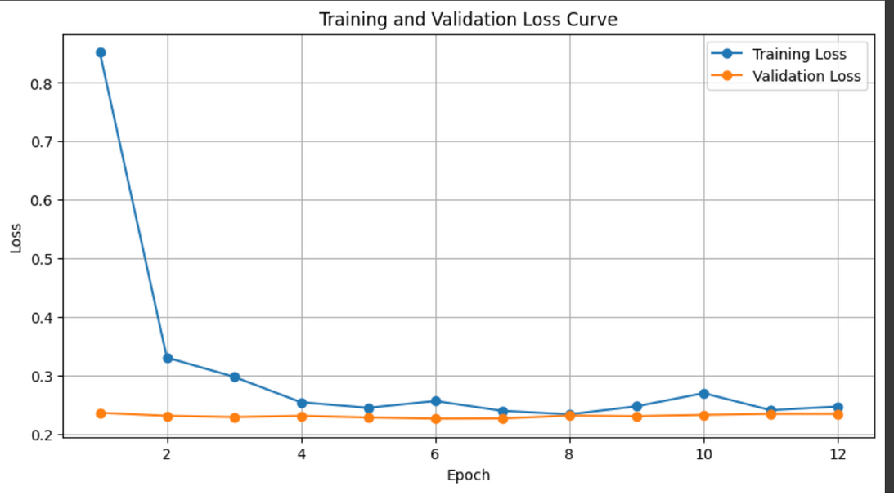
Model 4: Difficulty Adjuster Results

Slide 28
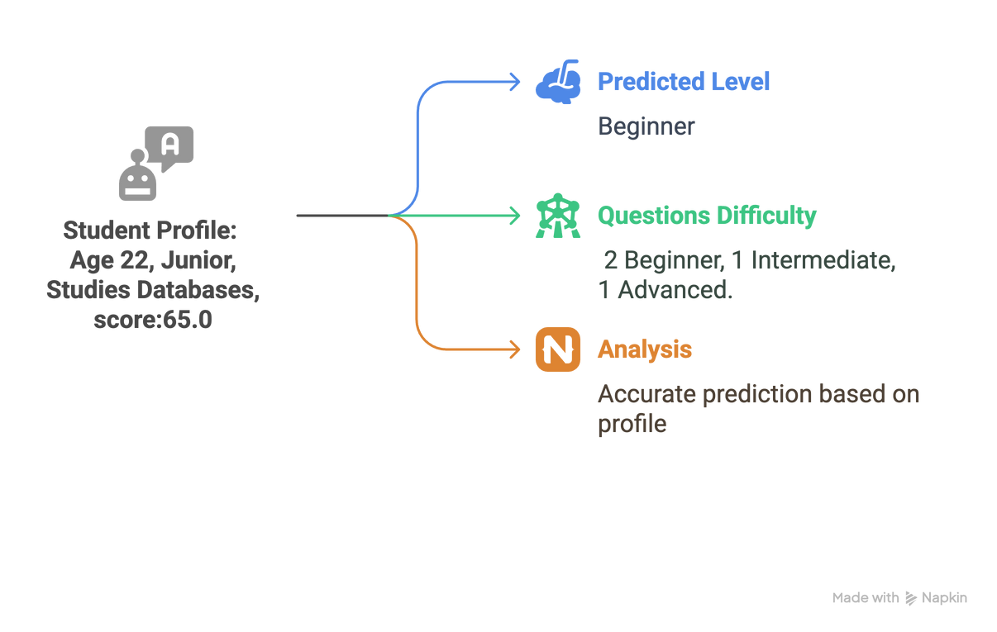
Model 4: Difficulty Adjuster Inference
The model was tested on the 2,250-sample test set and three example profiles. Predictions used the highest-probability class.
Test cases included:
1. Student Profile:
Age 22, Junior, Databases, Past Score 65.0,
Topic: SQL
Predicted: Beginner
Questions: 2 Beginner, 1 Intermediate, 1 Advanced (Databases Course)
Analysis: Accurate prediction.

Slide 29
CONCLUSION
Developed an AI-driven exam generator for personalized, scalable assessments.
Impact: Reduces educator workload, enhances computer science education.
Achievements: Outperformed benchmarks, introduced novel educational AI systems.

Slide 30

THANK YOU!
Q & A

Slide 31
References
[1] Raffel, C., et al. (2020). Exploring the Limits of Transfer Learning with a Unified Text-to-Text Transformer. arXiv:1910.10683.
[2] OpenAI. (2023). GPT-3.5 Technical Report. [https://openai.com/research/gpt-3-5]
[3] Devlin, J., et al. (2019). BERT: Pre-training of Deep Bidirectional Transformers for Language Understanding. arXiv:1810.04805.
[4] Fischer, K., Fürst, D., Steindl, S., Lindner, J., & Schäfer, U. (2024). Question: How do Large Language Models perform on the Question Answering tasks? Answer:. arXiv preprint arXiv:2412.12893. Accepted at SAI Computing Conference 2025
[5] Touvron, H., et al. (2023). LLaMA 2: Open Foundation and Fine-Tuned Chat Models. arXiv:2307.09288. [https://arxiv.org/abs/2307.09288]
[6] Barik, L., & Patel, B. (2010). HKDA-IQPGS: A true intelligent question paper generator system.

